Slide 1
How to Control Nonverbal Communication
Presented by Group 5

Slide 2
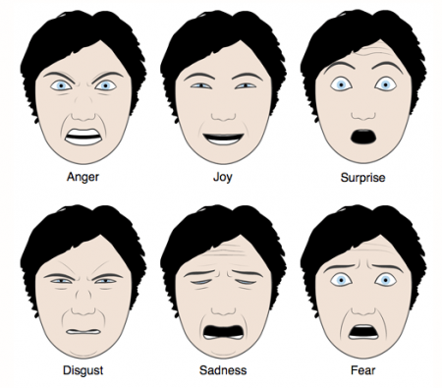
Definition
What is Nonverbal Communication?

Slide 3

Bad effect
May be misunderstood
May contradict the meanings
Nod indicates positive meaning while winking may contradict it
Can create tension in conversations

Slide 4
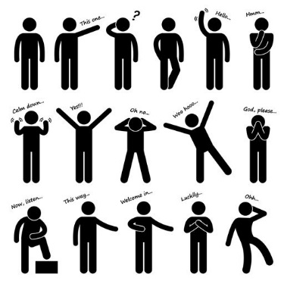
Tips
Pay attention
Looks for conflicting behaviour
Voice tone
Eye contacts
Asking question
Be aware

Slide 5
